Slide 1

New Student Orientation
Spring Semester 2025

Slide 2
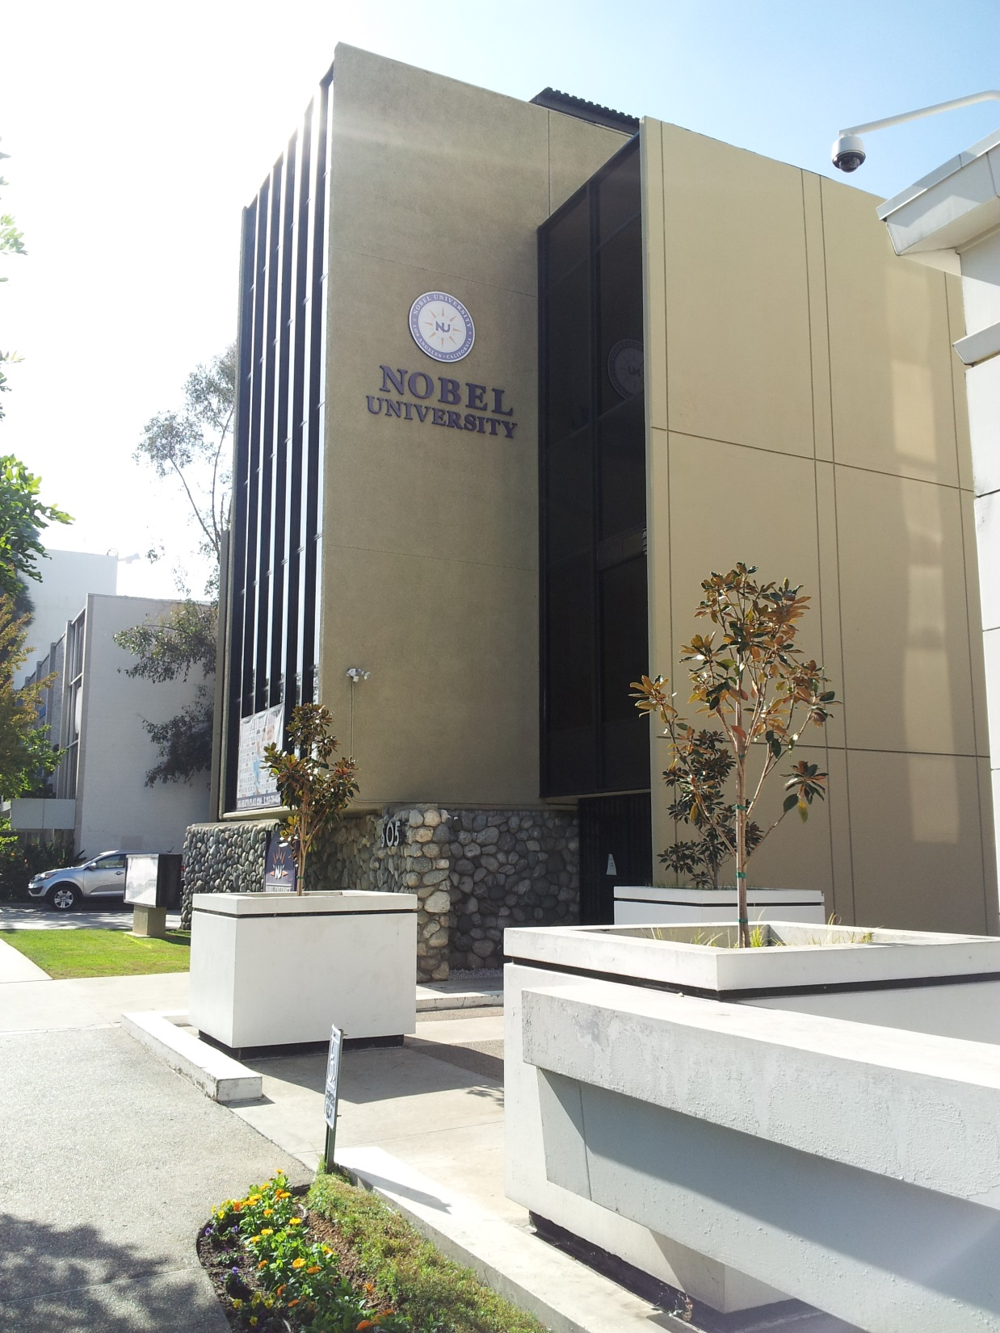
Welcome to your new future!

Slide 3
Meet our staff
President Chong S. Kim
Chief On-Site Administrator Ilsik Byun
Administrator of Admissions Junsuk Chang
Registrar Yoo Jin Jung
Finance Jeny Kim
Librarian Alida Montanez-Salas
Student Services John Hong

Slide 4

ACADEMIC PROGRAMS

Slide 5
Bachelor of arts in business administration
Programs is designed to broaden the spectrum of business courses with an understanding of cultural and sociological forces that shape business success.
Program length: 4 years
Minimum requirement per semester: 12 units
Graduation requirement: 120 units

Slide 6
Master of business administration
Program is designed to develop skills within the general function areas of business by utilizing a reality-centered academic experience through collaboration with the business community.
Program length: 2 years
Minimum requirement per semester: 9 units
Graduation requirement: 36 units (CPT is required to graduate from the program.)

Slide 7
Important dates
Semester begins: January 6, 2025
Last day to ADD/ DROP: January 17, 2025
Last day of class: April 25, 2025
Next semester begins: May 5, 2025

Slide 8
Holidays
University will be closed during these holidays:
  Martin Luther King Jr. Holiday:
  January 20, 2025
  Presidents’ Day Holiday:
  February 17, 2025

Slide 9
Library
Library hours (Restrictions might apply due to COVID-19)
  9 AM – 5 PM Monday – Friday
Books / Textbooks / Magazines / Newspaper
Online Library Catalog
  Nobel Online Library®
Research Tools
  Online Resources®
  eBooks®

Slide 10
Student handbook review
Institutional Information
  Statement of Non-discrimination/Equal Employment Opportunity
  Freedom of Speech
  Academic Freedom Policy
  Sexual Harassment
  Security and Safety

Slide 11
Student handbook review
Student Rights & Responsibilities
  Freedom of Access: all services and facilities
  Student Grievance Policy
  Student Code of Conduct
  Academic Dishonesty
    Plagiarism
    Copyright Policy
  Drug, Alcohol and Smoking Policy
  Weapons Policy

Slide 12

International students
During initial stay
  Apply for CA. Driver’s License
    Must be registered
  Bank Account
    Documents required: passport, visa, I-94, I-20
  Cellular Phone
    Prepaid phones available in major stores

Slide 13
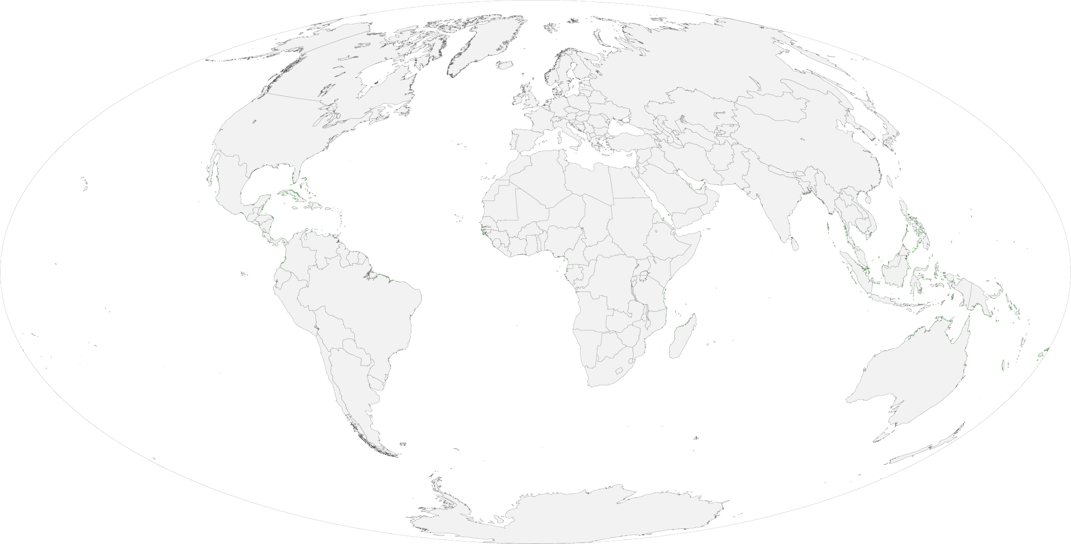
International students
Immigration documents
  Passport: issued by your country’s Embassy
  F-1 Visa: issued by the U.S. Embassy
  I-94: entry/ departure record
  I-20
    DSO must sign annually on page 2 (required for travel)
    Check if your information is correct
    Request reissue after updates
    Program completion date: last day of school

Slide 14
Annual vacation/ leave of absence
Annual Vacation
  Each summer
  May stay in the U.S.
  May work on-campus
  May study
Leave of Absence
  Medical reason
    Can stay in the U.S. (proper medical note required)
  Personal reason
    Must leave the U.S.
    Re-enter as early as 30 days prior next session start date
    Must notify DSO for I-20 to be changed back to “Active”

Slide 15
Transfer out
Complete an exit interview
Submit proper withdrawal documents
Clear all financial obligations
Submit the acceptance letter and transfer form from transfer-in school to the International Student Advisor (DSO)

Slide 16

Student services
Academic Advising
Activities: guest speakers, events
Career Services: workshops, job search, OPT
Graduation Ceremony

Slide 17

Welcome to Nobel University!

